Slide 1
Decision Tree Classification

Slide 2
Decision Trees
Classification trees
Regression trees

Slide 3
The goal of using a Decision Tree is to create a training model that can use to predict the class or value of the target variable by learning simple decision rules inferred from prior data (training data).
It is a tree-structured classifier, where internal nodes represent the features of a dataset, branches represent the decision rules and each leaf node represents the outcome
The decisions or the test are performed on the basis of features of the given dataset
A decision tree simply asks a question, and based on the answer (Yes/No), it further split the tree into subtrees

Slide 4
Decision Trees
They were popular around 25 years ago but then more sophisticated methods replaced them
Recently they were reborn with new upgrades
Additional methods that build on top of decision tress
Random forests, gradient boosting etc.
It is quite a simple method but it lies in the foundation of the some of the more modern and powerful methods
The family of decision tree learning algorithms includes algorithms like
ID3, CART, ASSISTANT, etc.

Slide 5
Decision tree
Has two types of nodes
Decision nodes
Specify a test based on which we decide which branch we should follow
This test is usually done on the value of a feature of the instance
Leaf nodes
Indicate the classification of an example or the value of the example
it can be the predicted value of the example for classification or regression or it can be a probability

Slide 6
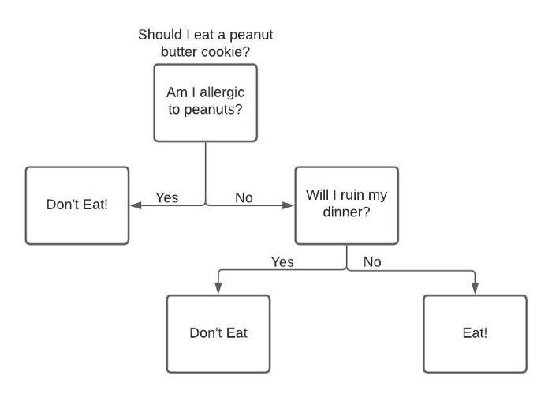
Decision tree Example
2 decision nodes
3 leaf nodes

Slide 7
We could have more than 2 children also for example if attribute has low, medium and high values then it will have three children
In case of multivalued attribute same attribute can be used again to split
A1
L, M
H
A1
L
M

Slide 8
Which decision tree we should choose
For the given training examples we have to generate decision tree
Given the training examples there is possibility
we can get many decision trees that fit the training examples
Which one we should choose
Or if the examples are noisy it could be that there is no decision which exactly fit the data
Which tree we should choose that has low error
Bias
Using bias we restrict the hypothesis space or we put preferences on the hypothesise space
Once we have chosen decision tree as the hypothesis space we can put some preference
Commonly preference for decision tree is to have tree with smaller trees (low depth or small no of nodes)

Slide 9
Come up with the algorithm that
Will search the space of the decision trees and given the training examples come up with the smallest decision tree that fits the data (if there is no noise).
But finding the smallest decision tree that fits the data is a computationally hard problem therefore we look for some greedy algorithm
We search for a good tree and we have to decide how we can come up with the good tree for learning

Slide 10
How the decision tree is build?
D (a set of training examples)
A5
Test on A5 attribute
D
Y
N
D1
A2
- with probability 0.82
D2
Y
N
+
A3
D11
D12
So we can grow the tree so that every leaf has a specific value or we stop at a point where at a leaf there are more than one possible values but one is more dominant.

Slide 11
The space of decision tree is too big for systematic search
Learning problem is given a set of decision trees we have to find a good tree
Two choices that we need to make at a time
Stop
Return a value for the target feature
Stopping criteria
If all the attributes are exhausted
If all the examples are positive/negative
If we get too few examples (say 2) in the node
Continue
Choose a test or choose an attribute to continue with

Slide 12
Top Down Induction of Decision trees ID3
1. A← the best decision attribute for the next node
2. Assign A as decision attribute for node
3. for each value of A create new descendent
4. sort training examples to leaf node according to the attribute value of the branch
5. if all training examples are perfectly classified (same value of target attribute) stop, else iterate over new leaf nodes.
Choices that we have to take in this algorithm
When we have the partial decision tee, which node to continue?
Which attribute to use for the test?
When to stop?

Slide 13
Advantages
Decision Trees usually mimic human thinking ability while making a decision, so it is easy to understand
The logic behind the decision tree can be easily understood because it shows a tree-like structure

Slide 14
Terminologies
Root Node
Root node is from where the decision tree starts
It represents the entire dataset, which further gets divided into two or more homogeneous sets
Decision Node
When a sub-node splits into further sub-nodes, then it is called the decision node
Leaf Node
Leaf nodes are the final output node, and the tree cannot be segregated further after getting a leaf node
Splitting
Splitting is the process of dividing the decision node/root node into sub-nodes according to the given conditions
Branch/Sub Tree
A tree formed by splitting the tree
Pruning
Pruning is the process of removing the unwanted branches from the tree
When we remove sub-nodes of a decision node, this process is called pruning
It is just the opposite process of splitting
Parent/Child node
The root node of the tree is called the parent node, and other nodes are called the child nodes

Slide 15
Working
Step-1: Begin the tree with the root node, says S, which contains the complete dataset
Step-2: Find the best attribute in the dataset using Attribute Selection Measure (ASM)
Step-3: Divide the S into subsets that contains possible values for the best attributes
Step-4: Generate the decision tree node, which contains the best attribute
Step-5: Recursively make new decision trees using the subsets of the dataset created in step -3. Continue this process until a stage is reached where you cannot further classify the nodes and called the final node as a leaf node

Slide 16
How to predicting the class of the given record
Start from the root node of the tree
This algorithm compares the values of root attribute with the record attribute and, based on the comparison, follows the branch and jumps to the next node
For the next node, the algorithm again compares the attribute value with the other sub-nodes and move further
It continues the process until it reaches the leaf node of the tree

Slide 17
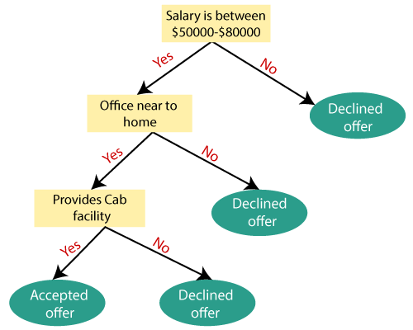
Example 1
Suppose there is a candidate who has a job offer and wants to decide whether he should accept the offer or Not.
To solve this problem, the decision tree starts with the root node (Salary attribute by ASM).
The root node splits further into the next decision node (distance from the office) and one leaf node based on the corresponding labels.
The next decision node further gets split into one decision node (Cab facility) and one leaf node.
Finally, the decision node splits into two leaf nodes (Accepted offers and Declined offer).

Slide 18
Example 2
X2
X1

Slide 19
Decision Tree
X2
60
Split 1
X1

Slide 20
Decision Tree
Split 2
X2
60
Split 1
50
X1

Slide 21
Decision Tree
Split 2
X2
60
Split 1
50
70
X1
Split 3

Slide 22
Decision Tree
Split 2
X2
60
Split 1
Split 4
50
70
X1
Split 3

Slide 23
Decision tree Intuition
Split is trying to minimize entropy
Optimal splits maximize number of different points in each one of these new leaf

Slide 24
Decision Tree
X2<60
X2
60
Split 1
X1

Slide 25
Decision Tree
X2<60
X1<70
X1<50
Split 2
X2
60
Split 1
50
X1

Slide 26
Decision Tree
X2<60
X1<70
X1<50
Split 2
X2
60
Split 1
50
70
X1
Split 3

Slide 27
Decision Tree
X2<60
X1<70
X1<50
Split 2
X2
X2<20
60
Split 1
20
Split 4
50
70
X1
Split 3

Slide 28
Decision Tree
X2<60
X1<70
X1<50
Split 2
X2
X2<20
60
Split 1
20
Split 4
50
70
X1
Split 3

Slide 29
In case of continuous data
Decision tree has difficulty to process continuous data.

Slide 30
SOP
Decision tree can be expressed as a Boolean function which is a disjunction of conjunction
Decision Trees follow Sum of Product (SOP) representation
The Sum of product (SOP) is also known as Disjunctive Normal Form
For a class, every branch from the root of the tree to a leaf node having the same class is conjunction (product) of values, different branches ending in that class form a disjunction (sum)

Slide 31
Attribute Selection Measures
While implementing a Decision tree, the main issue arises that how to select the best attribute for the root node and for sub-nodes
To solve such problems Attribute selection measure (ASM) is used
By this measurement, we can easily select the best attribute for the nodes of the tree
Which attribute to split on
Split gives smallest error

Slide 32
How to Split
Decision trees use multiple algorithms to decide to split a node into two or more sub-nodes
The creation of sub-nodes increases the homogeneity of resultant sub-nodes
In other words, we can say that the purity of the node increases with respect to the target variable
The decision tree splits the nodes on all available variables and then selects the split which results in most homogeneous sub-nodes

Slide 33
There are two popular techniques for ASM, which are:
Information Gain
Gini Index
In case of Continuous Target Variable
Reduction in Variance
In case of Categorical Target Variable
Gini Impurity
Information Gain
Chi-Square

Slide 34
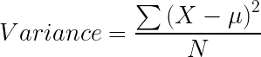
Decision Tree Splitting: Reduction in Variance
Reduction in Variance is a method for splitting the node used when the target variable is continuous, i.e., regression problems.
it uses variance as a measure for deciding the feature on which node is split into child nodes.

Slide 35
Decision Tree Splitting: Reduction in Variance
Variance is used for calculating the homogeneity of a node. If a node is entirely homogeneous, then the variance is zero.
Steps to split a decision tree using reduction in variance:
For each split, individually calculate the variance of each child node
Calculate the variance of each split as the weighted average variance of each child nodes
Select the attribute for split having minimum split variance
Perform steps 1-3 until completely homogeneous nodes are achieved

Slide 36
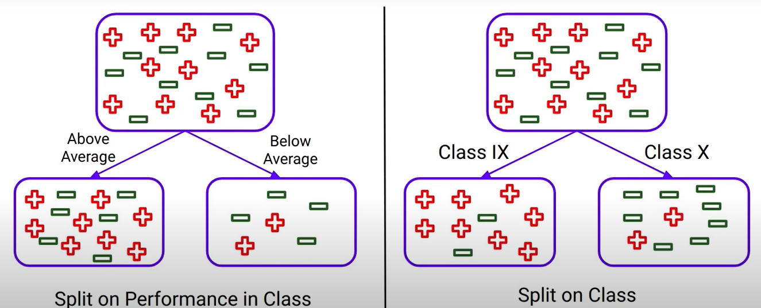

Slide 37
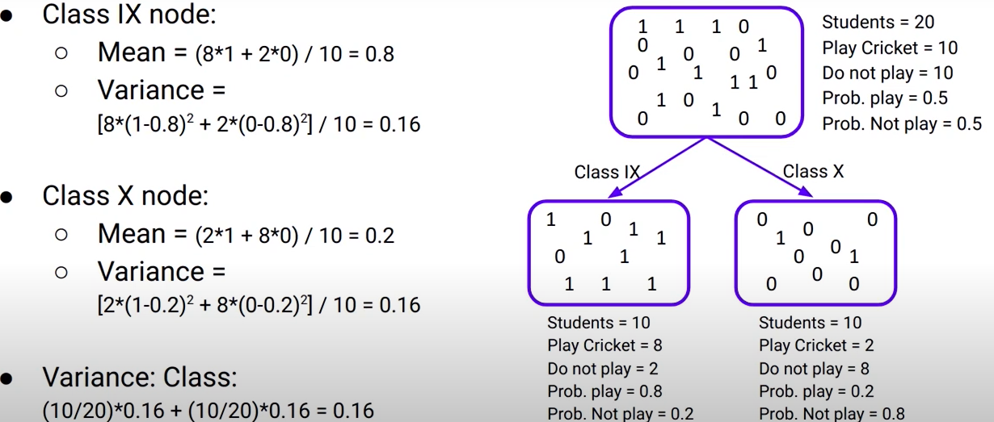

Slide 38
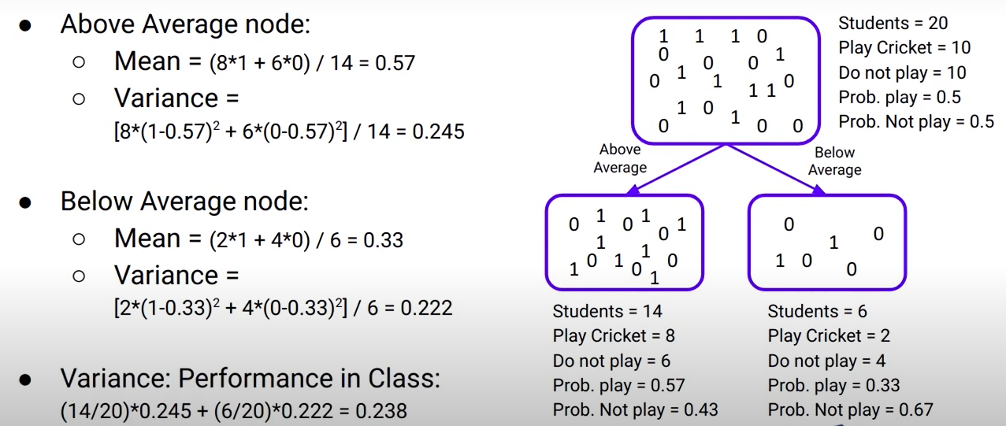

Slide 39
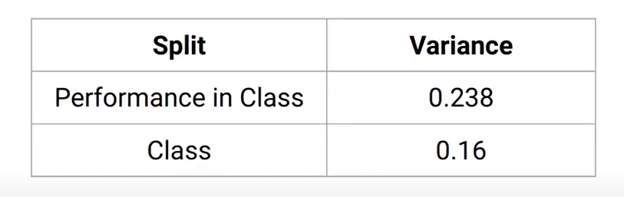

Slide 40
Entropy
Is a measure of disorder in a system
It is used to measure the impurity or randomness or uncertainty of a dataset

Slide 41
Entropy
When a target feature contains more than one type of element (balls of different colors in a box), it is useful to sum up the entropies of each possible target value and weigh it by the probability of getting these values assuming a random draw
This finally leads us to the formal definition of Shannon’s entropy which serves as the baseline for the information gain calculation:
Where P(x=k) is the probability that a target feature takes a specific value, k
Or Entropy (S)= P₊ (-log₂P₊) + P₋ (-log₂P₋) where P+ and P- are fraction of positive and negative examples in Sample S

Slide 42
Entropy
Logarithm of fractions gives a negative value and hence a ‘-‘ sign is used in entropy formula to negate these negative values
The maximum value for entropy depends on the number of classes

Slide 43
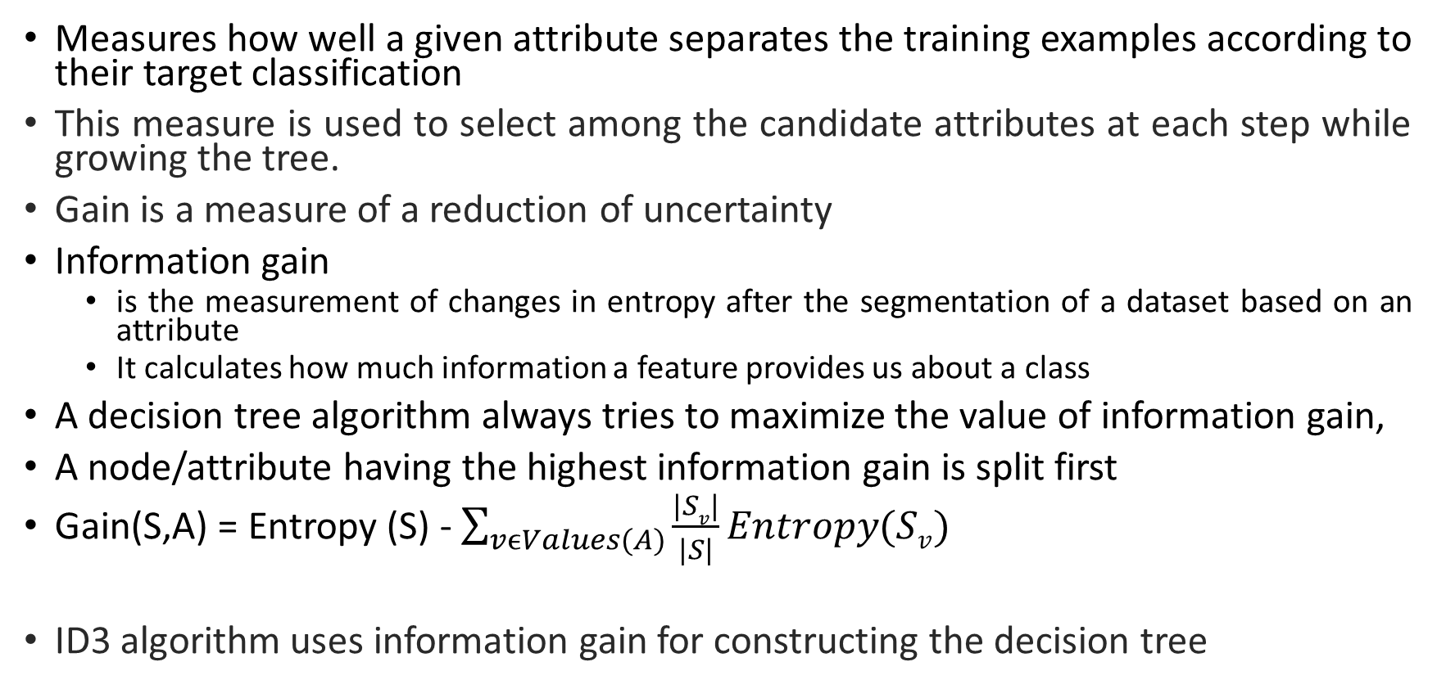
Information Gain

Slide 44
Information Gain
Gain(S,A): expected reduction in entropy due to partitioning S on attribute A
29+, 35-
A1=?=?
A2=?
29+, 35-
True
False
True
False
21+, 5-=?
8+, 30-
18+, 33-
11+, 2-

Slide 45
For previous example:
Entropy([29+,35-]) = -29/64 log₂ 29/64 – 35/64 log₂ 35/64 = 0.99
Entropy([21+,5-]) =0.71 Entropy([18+,33-]) =0.94
Entropy([8+,30-]) =0.71 Entropy([11+,2-]) =0.94
Gain(S,A1)= Entropy(S) – 26/64 * Entropy([21+,5-]) – 38/64 * Entropy([8+,30-]) =0.27
Gain(S,A2)= Entropy(S) – 51/64 * Entropy([18+,33-]) – 13/64 * Entropy([11+,2-]) =0.12
So according this measure A1 gets selected for splitting

Slide 46
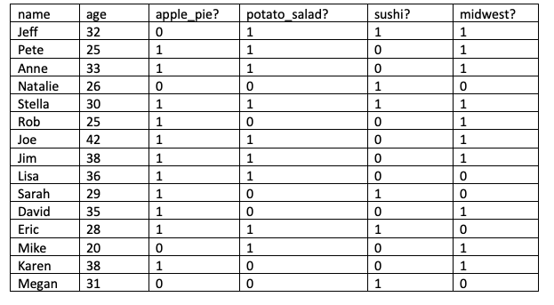
Example
The goal of the quiz will be to guess if the quiz taker is from one of America’s midwest states.

Slide 47
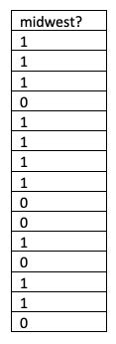
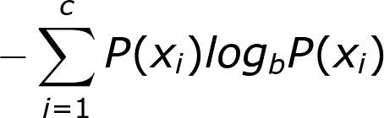
Entropy
We then compute the probability of that value occurring in the data.
For the case of (1), the probability is 10/15.
For the case of (0), the probability is 5/15.
We take the probability of each case and multiply it by the logarithm base 2 of the probability.
For the case of(1), we get 10/15*log2(10/15).
For the case of (0), we get 5/15*log2(5/15).
Next, we take our product from each case above and sum it together. For this example, -{10/15*log2(10/15) + 5/15*log2(5/15)}= .918278

Slide 48
Goal in building the Decision tree
Our goal is to find the best variable(s)/column(s) to split on when building a decision tree.
Eventually, we want to keep splitting the variables/columns until our mixed target column is no longer mixed.
For instance, let’s look at the entropy of the “midwest?” column after we have split our dataset on the “potato_salad?” column.

Slide 49
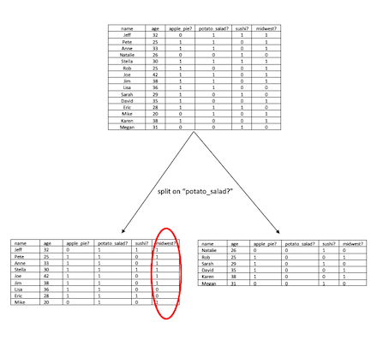
Splitting the dataset on the “potato_salad”

Slide 50
Calculating Information gain
for each unique value (v) in the feature considered, we compute the number of rows which takes on the value (v), and divide it by the total number of rows.
For the left split( split on 1 for “potato_salad?”) we get -7/9 *log2 (7/9)
For the right side of the split ( split on 0 for “potato_salad?”) we get -2/9 * log2 (2/9)
Weighted entropy of split= 9/15 * {- 7/9* log2 (7/9) } + 6/15 * {- 2/9 * log2 (2/9) }
We then subtract from the overall entropy to get information gain
.918278 – [9/15 * {- 7/9* log2 (7/9)} + 6/15 * {- 2/9 * log2 (2/9)}]
This process is repeated for every column

Slide 51
Another (Splitting Rule):
Gini Index/Gini Impurity
Measure of node impurity
A Decision tree algorithm for selecting the best split
Used in CART

Slide 52
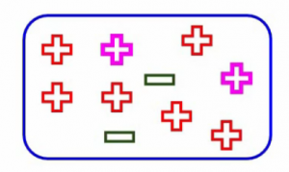
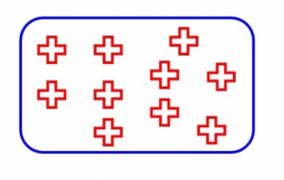
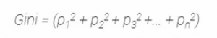
Gini
If we pick two points from a population at random what is the probability of getting both points from same class (the pink ones highlighted here)
completely pure node-
probability that randomly picked point will belong to the same class-1
Gini ranges from zero to one, as it is a probability
The higher this value, the more will be the purity of the nodes.
a lesser value means lesser pure nodes.
It is the sum of squared probabilities of each class

Slide 53
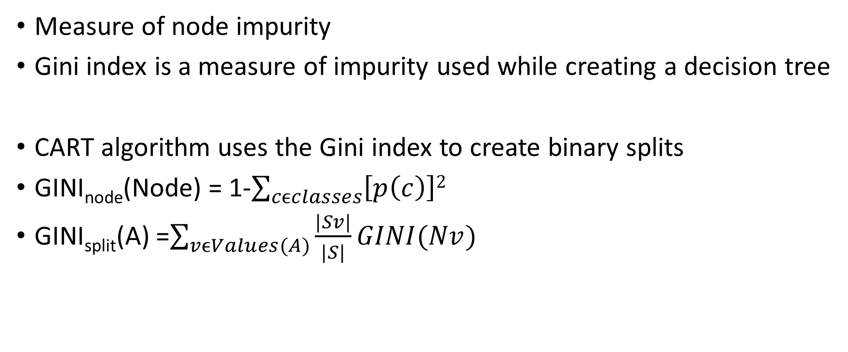
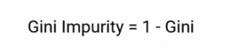
Gini Index/Gini Impurity

Slide 54
Gini Index/Gini Impurity
Gini index or Gini impurity measures the degree or probability of a particular variable being wrongly classified when it is randomly chosen.
The degree of Gini index varies between 0 and 1, where,
0 denotes that all elements belong to a certain class or if there exists only one class, and
1 denotes that the elements are randomly distributed across various classes.
0.5 denotes equally distributed elements into some classes.

Slide 55
Properties of Gini impurity
We decide the best split based on the Gini impurity
Gini denotes the purity and hence Gini impurity tells us about the impurity of nodes
Lower the Gini impurity we can safely infer the purity will be more and hence a higher chance of the homogeneity of the nodes.

Slide 56
Properties of Gini impurity
Gini works only in those scenarios where we have categorical targets.
It does not work with continuous targets.
For example, if you want to predict the house price or the number of bikes that have been rented, Gini is not the right algorithm.

Slide 57
Steps to calculate Gini Impurity
1. Calculate the Gini impurity for sub-nodes
2. Calculate the Gini impurity of the split using the weighted impurity of both sub-nodes of that split.
Here the weight is decided by the number of observations of samples in both the nodes.

Slide 58
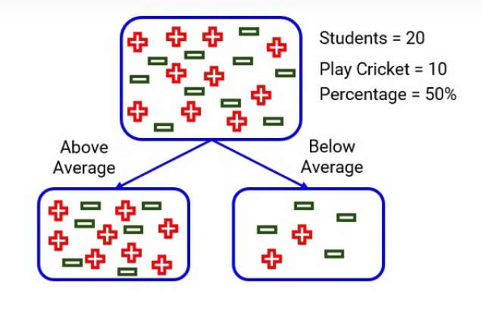

Slide 59
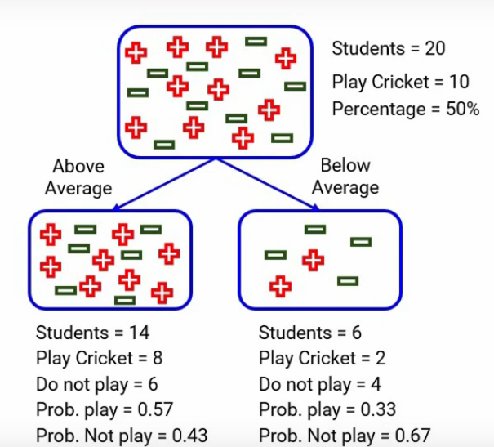
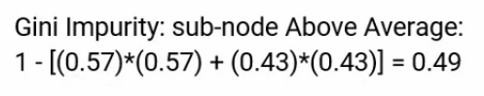
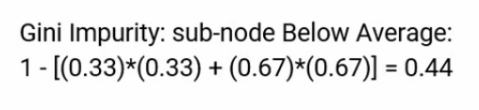
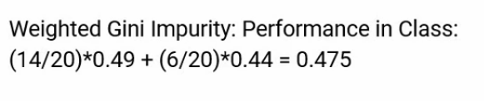
Split on Performance in Class

Slide 60
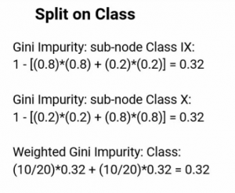

Slide 61
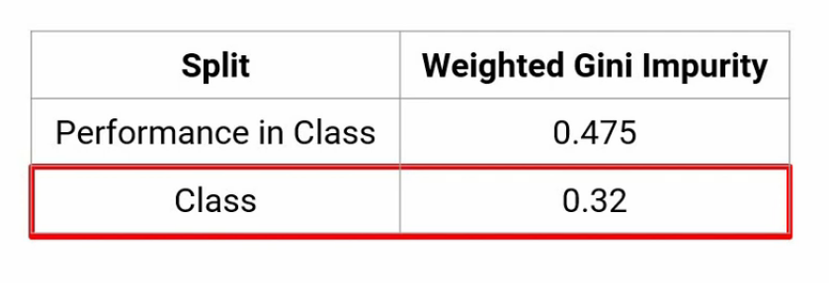

Slide 62
Example of Gini Index
Past Trend | Open Interest | Trading Volume | Return
Positive | Low | High | Up
Negative | High | Low | Down
Positive | Low | High | Up
Positive | High | High | Up
Negative | Low | High | Down
Positive | Low | Low | Down
Negative | High | High | Down
Negative | Low | High | Down
Positive | Low | Low | Down
Positive | High | High | Up

Slide 63
Calculating the Gini Index for Past Trend
P(Past Trend=Positive): 6/10
P(Past Trend=Negative): 4/10
If (Past Trend = Positive & Return = Up), probability = 4/6
If (Past Trend = Positive & Return = Down), probability = 2/6
Gini index = 1 - ((4/6)^2 + (2/6)^2) = 0.45
If (Past Trend = Negative & Return = Up), probability = 0
If (Past Trend = Negative & Return = Down), probability = 4/4
Gini index = 1 - ((0)^2 + (4/4)^2) = 0
Weighted sum of the Gini Indices can be calculated as follows:
Gini Index for Past Trend = (6/10)0.45 + (4/10)0 = 0.27

Slide 64
Calculation of Gini Index for Open Interest
P(Open Interest=High): 4/10
P(Open Interest=Low): 6/10
If (Open Interest = High & Return = Up), probability = 2/4
If (Open Interest = High & Return = Down), probability = 2/4
Gini index = 1 - ((2/4)^2 + (2/4)^2) = 0.5
If (Open Interest = Low & Return = Up), probability = 2/6
If (Open Interest = Low & Return = Down), probability = 4/6
Gini index = 1 - ((2/6)^2 + (4/6)^2) = 0.45
Weighted sum of the Gini Indices can be calculated as follows:
Gini Index for Open Interest = (4/10)0.5 + (6/10)0.45 = 0.47

Slide 65
Calculation of Gini Index for Trading Volume
P(Trading Volume=High): 7/10
P(Trading Volume=Low): 3/10
If (Trading Volume = High & Return = Up), probability = 4/7
If (Trading Volume = High & Return = Down), probability = 3/7
Gini index = 1 - ((4/7)^2 + (3/7)^2) = 0.49
If (Trading Volume = Low & Return = Up), probability = 0
If (Trading Volume = Low & Return = Down), probability = 3/3
Gini index = 1 - ((0)^2 + (1)^2) = 0
Weighted sum of the Gini Indices can be calculated as follows:
Gini Index for Trading Volume = (7/10)0.49 + (3/10)0 = 0.34

Slide 66
Gini Index attributes or features
Attributes/Features | Gini Index
Past Trend | 0.27
Open Interest | 0.47
Trading Volume | 0.34
From the above table, we observe that ‘Past Trend’ has the lowest Gini Index and hence it will be chosen as the root node for how decision tree works.
We will repeat the same procedure to determine the sub-nodes or branches of the decision tree.

Slide 67
Gini Index for the ‘Positive’ branch of Past Trend
Past Trend | Open Interest | Trading Volume | Return
Positive | Low | High | Up
Positive | Low | High | Up
Positive | High | High | Up
Positive | Low | Low | Down
Positive | Low | Low | Down
Positive | High | High | Up

Slide 68
Calculation of Gini Index of Open Interest for Positive Past Trend
P(Open Interest=High): 2/6
P(Open Interest=Low): 4/6
If (Open Interest = High & Return = Up), probability = 2/2
If (Open Interest = High & Return = Down), probability = 0
Gini index = 1 - (sq(2/2) + sq(0)) = 0
If (Open Interest = Low & Return = Up), probability = 2/4
If (Open Interest = Low & Return = Down), probability = 2/4
Gini index = 1 - (sq(0) + sq(2/4)) = 0.50
Weighted sum of the Gini Indices can be calculated as follows:
Gini Index for Open Interest = (2/6)0 + (4/6)0.50 = 0.33

Slide 69
Calculation of Gini Index for Trading Volume for Positive Past Trend
P(Trading Volume=High): 4/6
P(Trading Volume=Low): 2/6
If (Trading Volume = High & Return = Up), probability = 4/4
If (Trading Volume = High & Return = Down), probability = 0
Gini index = 1 - (sq(4/4) + sq(0)) = 0
If (Trading Volume = Low & Return = Up), probability = 0
If (Trading Volume = Low & Return = Down), probability = 2/2
Gini index = 1 - (sq(0) + sq(2/2)) = 0
Weighted sum of the Gini Indices can be calculated as follows:
Gini Index for Trading Volume = (4/6)0 + (2/6)0 = 0

Slide 70
Gini Index attributes or features
Attributes/Features | Gini Index
Open Interest | 0.33
Trading Volume | 0
We will split the node further using the ‘Trading Volume’ feature, as it has the minimum Gini index.

Slide 71
Gini Index, unlike information gain, isn’t computationally intensive as it doesn’t involve the logarithm function used to calculate entropy in information gain.
This is why Gini Index is preferred over Information gain.

Slide 72
Splitting based on continuous attribute
We discussed decision tree if training example contains an attribute having 2 or 3 or 4 values i.e. if attributes are nominal values
What if the training examples have real valued examples
Height >5 fEet?
Height?
yes
NO
<4ft
[5.5ft, 6ft)
Binary split
[4ft, 4’5ft)
[5ft, 5.5ft)
[4.5ft, 5ft)
Multiway split

Slide 73
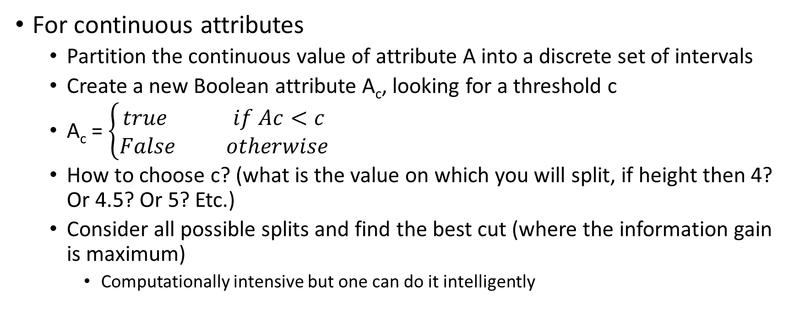
Continuous Attribute - Binary Split

Slide 74
Dealing with continuous-values attributes
Example: temperature in the playTennis
Sort the examples according to Temperature
Temperature 40 48 60 72 80 90
PlayTennis No No Yes Yes Yes No
Steps to decide the value of temperature to split the node
1. Determine the candidate thresholds by averaging consecutive values where there is a change in classification: (48+60)/2= 54 and (80+90)/2 =85
2. Evaluate information gain of candidate thresholds (attributes) temperature>54 and Temperature>85
3. Select threshold based on the information gain

Slide 75
Entropy of whole dataset (S)
S= [3+, 3-] Entropy(S)= -3/6 log₂ 3/6 – 3/6 log₂ 3/6 = 1.0
S_{T<54}= [0+, 2-] Entropy(S_{T<54})=0.0
S_{T>54} =[3+, 1-] Entropy(S_{T>54})= -3/4 log₂ 3/4 – 1/4 log₂ 1/4 = 0.8113
Gain(S, T>54) = Entropy(S)- 2/6xEntropy(S_{T<54})- 4/6x Entropy(S_{T>54})
= 0.4591

Slide 76
Entropy of whole dataset (S)
S= [3+, 3-] Entropy(S)= -3/6 log₂ 3/6 – 3/6 log₂ 3/6 = 1.0
S_{T<84}= [3+, 2-] Entropy(S_{T<84})= -3/5 log₂ 3/5 – 2/5 log₂ 2/5 = 0.971
S_{T>84} =[0+, 1-] Entropy(S_{T>84})= 0.0
Gain(S, T>84) = Entropy(S)- 5/6xEntropy(S_{T<84})- 1/6x Entropy(S_{T>84})
= 0.1908

Slide 77
Gain(S, T>54) = 0.4591
Gain(S, T>84) = 0.1908

Slide 78
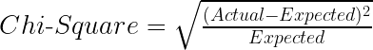
Decision Tree Splitting: Chi-Square
Another method of splitting nodes in a decision tree for datasets having categorical target values.
It can make two or more than two splits.
It works on the statistical significance of differences between the parent node and child nodes.
It is measured as the sum of squared standardized differences between observed and expected frequencies of target variable for each node
Chi-Square value is:

Slide 79
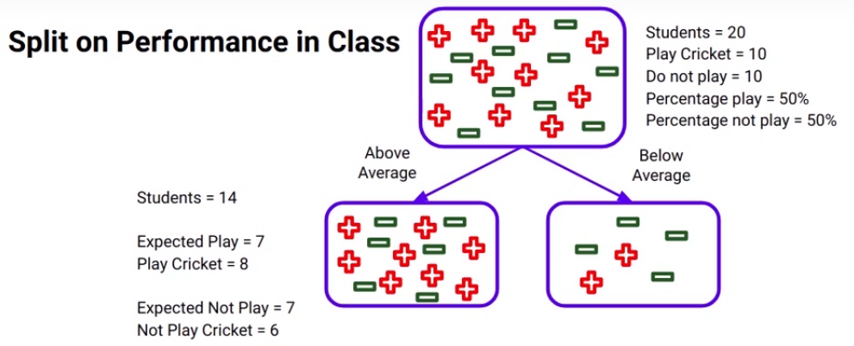
Example

Slide 80
There is a total of 20 students and out of those 10 play cricket and 10 do not.
So, of course, the percent of students who do play cricket will be 50%.
Now if we consider the “Above average” node here,
there are 14 students in it, as the percentage of students who play cricket is 50% in the parent node as we discussed,
the expected number of students who play cricket will of course be 7 and if you look at the actual value it is 8.
So expected value-7 and actual value-8
Similarly, the expected number of students who do not play cricket will be 7 and the actual value turns out to be 6.
Similarly for the below-average node expected to play and not play will be 3. Whereas the actual values are- 2 students play cricket and 4 do not.

Slide 81
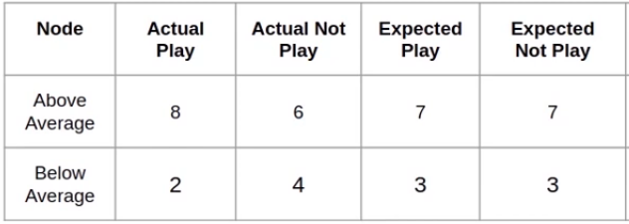

Slide 82
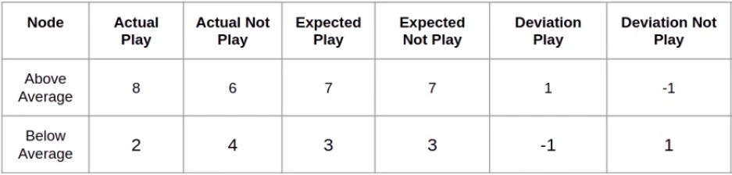

Slide 83
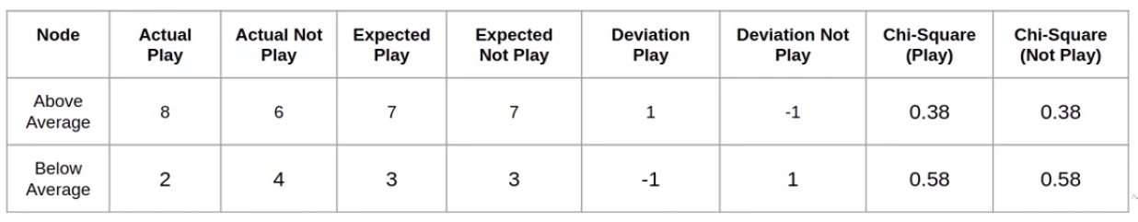
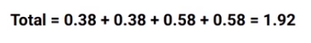
Chi-square for the split in “performance in class” will be the sum of all these chi-square values:

Slide 84
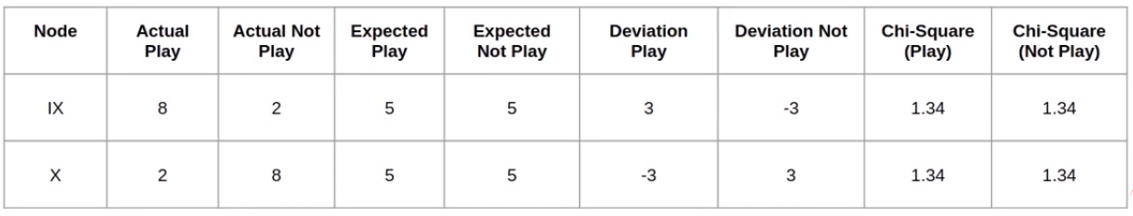
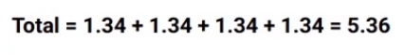
Split on class
chi-square value for the split on class which will be the sum of all chi-square values:

Slide 85
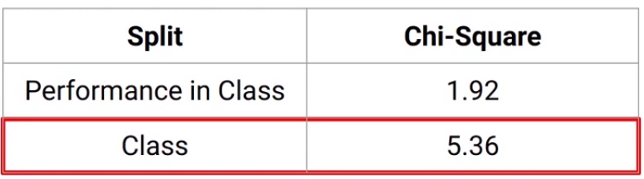

Slide 86
what will be the chi-square value if the actual and expected values are the same?
It will be zero because both the actual and expected are the same and the difference will be zero.
In this case, distribution of the child node is the same as there is the parent node and hence we are not improving the purity of the nodes.
Higher the chi-square value more will be the purity of the nodes after a split.

Slide 87
Pruning: Getting an Optimal Decision tree
Pruning is a process of deleting the unnecessary nodes from a tree in order to get the optimal decision tree.
A too-large tree increases the risk of overfitting, and a small tree may not capture all the important features of the dataset.
Therefore, a technique that decreases the size of the learning tree without reducing accuracy is known as Pruning.
There are mainly two types of tree pruning technology used:
Cost Complexity Pruning
Reduced Error Pruning

Slide 88
advantages of the Decision Tree
It is simple to understand as it follows the same process which a human follow while making any decision in real-life
It can be very useful for solving decision-related problems
It helps to think about all the possible outcomes for a problem.
There is less requirement of data cleaning compared to other algorithms.

Slide 89
Disadvantages of the Decision Tree
The decision tree contains lots of layers, which makes it complex
It may have an overfitting issue, which can be resolved using the Random Forest algorithm
For more class labels, the computational complexity of the decision tree may increase

Slide 90
Importing the libraries
import numpy as np
import matplotlib.pyplot as plt
import pandas as pd

Slide 91
Importing the dataset
dataset = pd.read_csv('Social_Network_Ads.csv’)
x = dataset.iloc[:, :-1].values
y = dataset.iloc[:, -1].values
Age EstimatedSalary Purchased
19 19000 0
35 20000 0
26 43000 0
27 57000 0
19 76000 0
27 58000 0
27 84000 0
32 150000 1
25 33000 0
Total- 1000 entries

Slide 92
Splitting the dataset into the Training set and Test set
from sklearn.model_selection import train_test_split
X_train, X_test, y_train, y_test = train_test_split(X, y, test_size = 0.25, random_state = 0)

Slide 93
Feature Scaling
from sklearn.preprocessing import StandardScaler
sc = StandardScaler()
X_train = sc.fit_transform(X_train)
X_test = sc.transform(X_test)

Slide 94
Training the Decision Tree Classification model on the Training set
from sklearn.tree import DecisionTreeClassifier
classifier = DecisionTreeClassifier(criterion = 'entropy', random_state = 0)
classifier.fit(X_train, y_train)

Slide 95
Predicting a new result
print(classifier.predict(sc.transform([[30,87000]])))
Output
[0]

Slide 96
Predicting the Test set results
y_pred = classifier.predict(X_test)
print(np.concatenate((y_pred.reshape(len(y_pred),1), y_test.reshape(len(y_test),1)),1))

Slide 97
Making the Confusion Matrix
from sklearn.metrics import confusion_matrix, accuracy_score
cm = confusion_matrix(y_test, y_pred)
print(cm)
accuracy_score(y_test, y_pred)
Output
[[62 6]
[ 3 29]
0.91

Slide 98
Visualising the Training set results
from matplotlib.colors import ListedColormap
X_set, y_set = sc.inverse_transform(X_train), y_train
X1, X2 = np.meshgrid(np.arange(start = X_set[:, 0].min() - 10, stop = X_set[:, 0].max() + 10, step = 0.25),
np.arange(start = X_set[:, 1].min() - 1000, stop = X_set[:, 1].max() + 1000, step = 0.25))
plt.contourf(X1, X2, classifier.predict(sc.transform(np.array([X1.ravel(), X2.ravel()]).T)).reshape(X1.shape),
alpha = 0.75, cmap = ListedColormap(('red', 'green')))
plt.xlim(X1.min(), X1.max())
plt.ylim(X2.min(), X2.max())
for i, j in enumerate(np.unique(y_set)):
plt.scatter(X_set[y_set == j, 0], X_set[y_set == j, 1], c = ListedColormap(('red', 'green'))(i), label = j)
plt.title('Decision Tree Classification (Training set)')
plt.xlabel('Age')
plt.ylabel('Estimated Salary')
plt.legend()
plt.show()

Slide 99
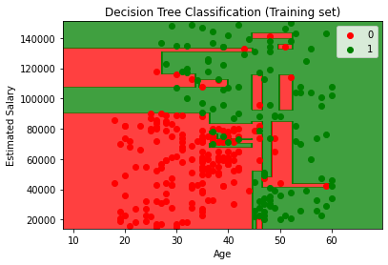
Visualising the Training set results

Slide 100
Visualising the Test set results
from matplotlib.colors import ListedColormap
X_set, y_set = sc.inverse_transform(X_test), y_test
X1, X2 = np.meshgrid(np.arange(start = X_set[:, 0].min() - 10, stop = X_set[:, 0].max() + 10, step = 0.25),
np.arange(start = X_set[:, 1].min() - 1000, stop = X_set[:, 1].max() + 1000, step = 0.25))
plt.contourf(X1, X2, classifier.predict(sc.transform(np.array([X1.ravel(), X2.ravel()]).T)).reshape(X1.shape),
alpha = 0.75, cmap = ListedColormap(('red', 'green')))
plt.xlim(X1.min(), X1.max())
plt.ylim(X2.min(), X2.max())
for i, j in enumerate(np.unique(y_set)):
plt.scatter(X_set[y_set == j, 0], X_set[y_set == j, 1], c = ListedColormap(('red', 'green'))(i), label = j)
plt.title('Decision Tree Classification (Test set)')
plt.xlabel('Age')
plt.ylabel('Estimated Salary')
plt.legend()
plt.show()

Slide 101
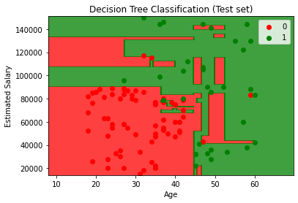
Visualising the Test set results

